Slide 1

College tuition, diversity, & Pay
NYC Data Science Academy
Python Data Analysis Project
Edward Weldon
6/13/2025

Slide 2

Background
Tuition costs keep rising along with student debt
Graduates often wind up in career paths that have little to do with their degrees
Even take bootcamps to learn more technical field (like Data Science)
Large Language Models like ChatGPT are also diminishing the value of many degrees
With even more AI automation to come

Slide 3
Questions
Is College still worth it?
For Everyone?
Which Schools, Types, States, Sizes, …
Goals
Give parents & students perspective to make better college & career choices
Push colleges to make programs more profitable for students
To Assess
Net Present Value (NPV) of College Costs and Future Earnings

Slide 4

Present Value (PV)
Present Day equivalent of future Income or Expenses
Having $50 today is better than receiving $50 in a year
PV = FV / (1 + r)^{n} where..
FV = Future Payment (Income or Expense)
r = Rate of Return on Investment (Discount Rate)
After-Tax Real Rate of Return on S&P 500 will be used here (10-yr avg)
Return net of Taxes and Inflation- 6% annualized
n = time till payment (# of years, weeks, …)

Slide 5

Data Collection & Overview
Kaggle 'College tuition, diversity, and pay' dataset
https://www.kaggle.com/datasets/jessemostipak/college-tuition-diversity-and-pay?resource=download&select=tuition_cost.csv
Usability Score 10, code notebooks, many views & downloads
Updated 5 yrs ago, mostly data from 2018-2019
5 files- 33 columns with wide range of String & Integer values
Tuition Cost
Salary Potential
Diversity School
Tuition Income
Historical Tuition

Slide 6
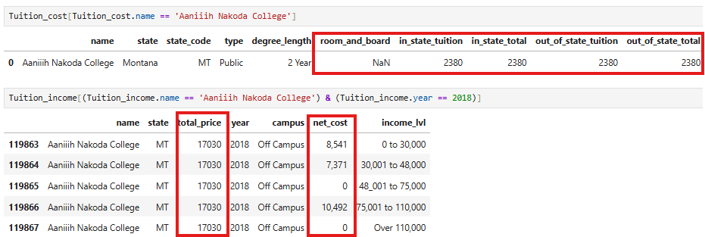
Data Inspection
Null & Duplicate Values
‘Tuition Income’ file unusable

Slide 7
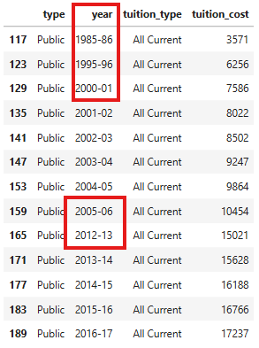
Data Inspection
‘Historical Tuition’ file unusable for this analysis
Now down to 3 files
Tuition Cost
Salary Potential
Diversity School

Slide 8
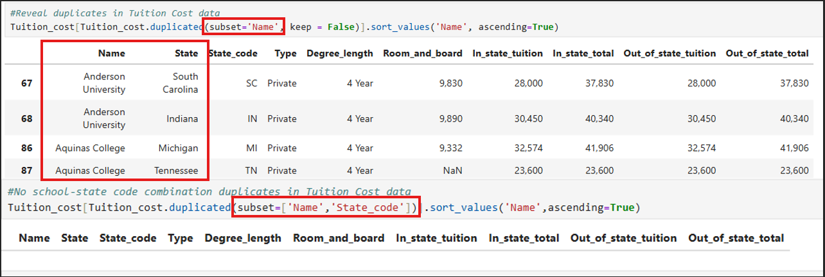
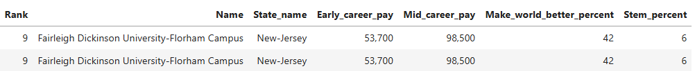
Data cleaning
Capitalization, Integer conversions, Output Display reformatting
Duplicates

Slide 9
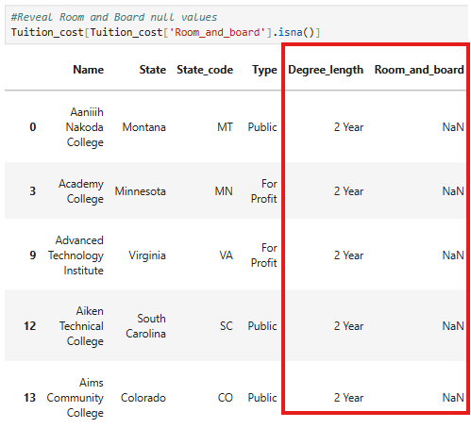
Data cleaning
NULL Room and Board

Slide 10
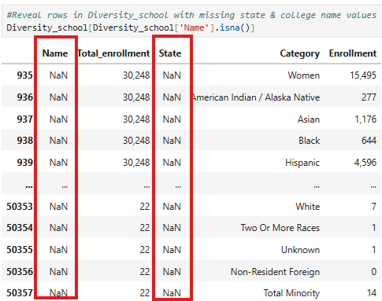
Data Cleaning
NULL values in Diversity School

Slide 11
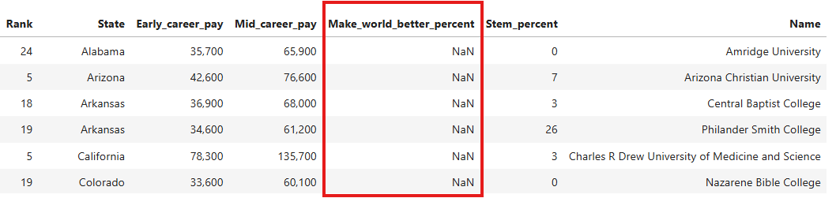
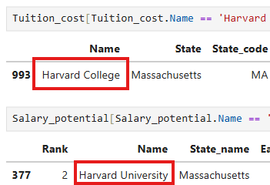
Data cleaning
NULL Values in Salary Potential
Many Colleges had to be renamed to align in all 3 tables

Slide 12
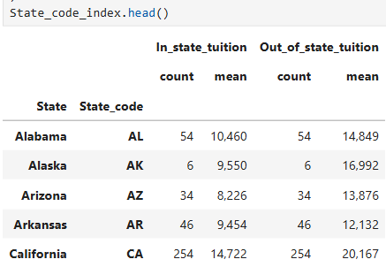

Data Transformation
Name- State index columns

Slide 13
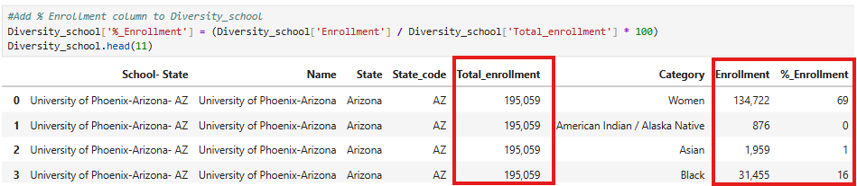

Data Transformation
Diversity School % Enrollment
Single Row Copies

Slide 14
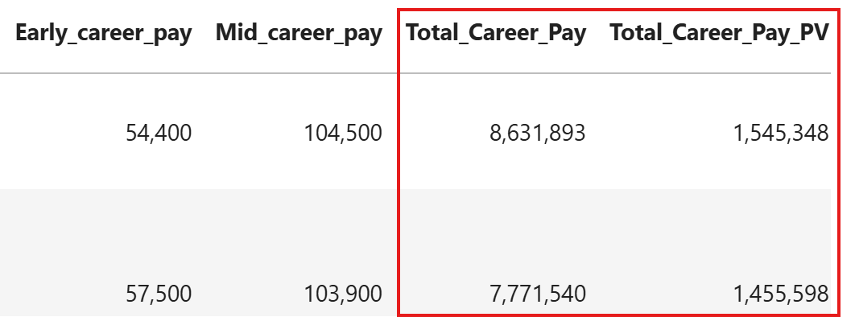
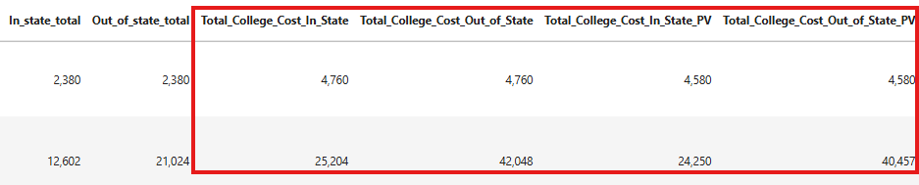
Data Transformation
Total Career Pay
Total Cost

Slide 15
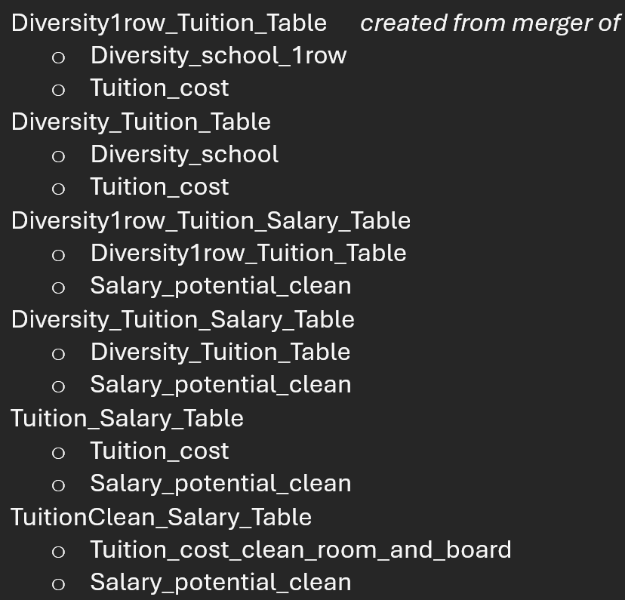
Data Transformation- Merging
Many combinations to minimize data loss for different plots

Slide 16
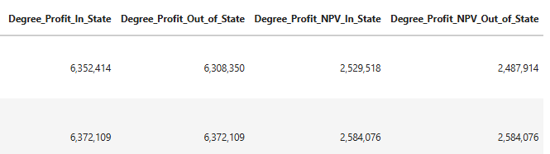
Data Transformation- Merging
Tuition Cost- Salary Potential Merges
Career Pay formula adjustments by Degree Length
Net Present Value functions added for Degree Profit

Slide 17
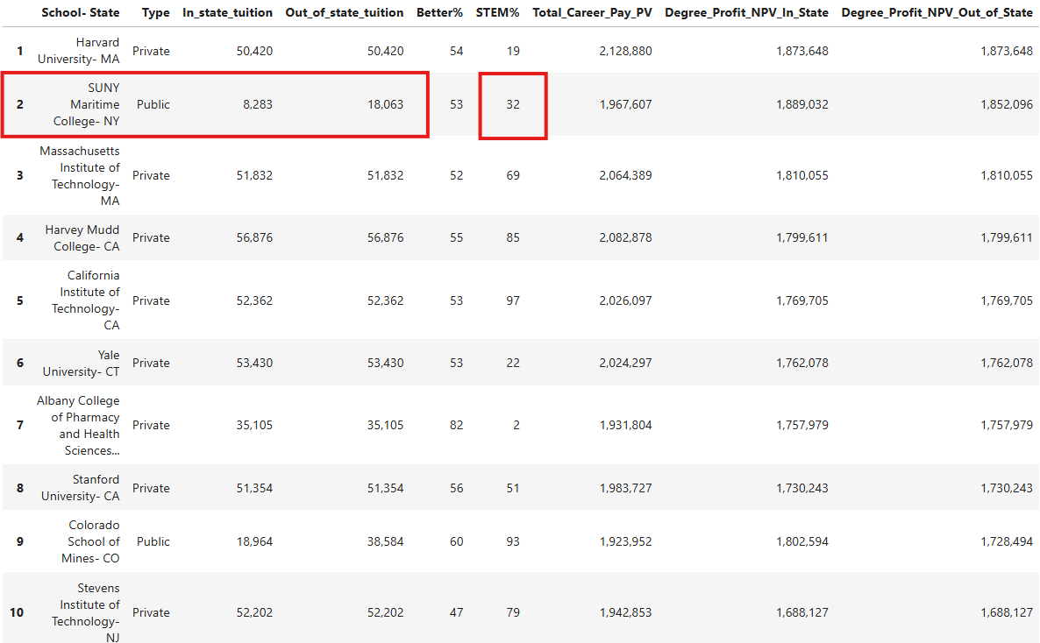
Analysis- By college
Most Profitable

Slide 18
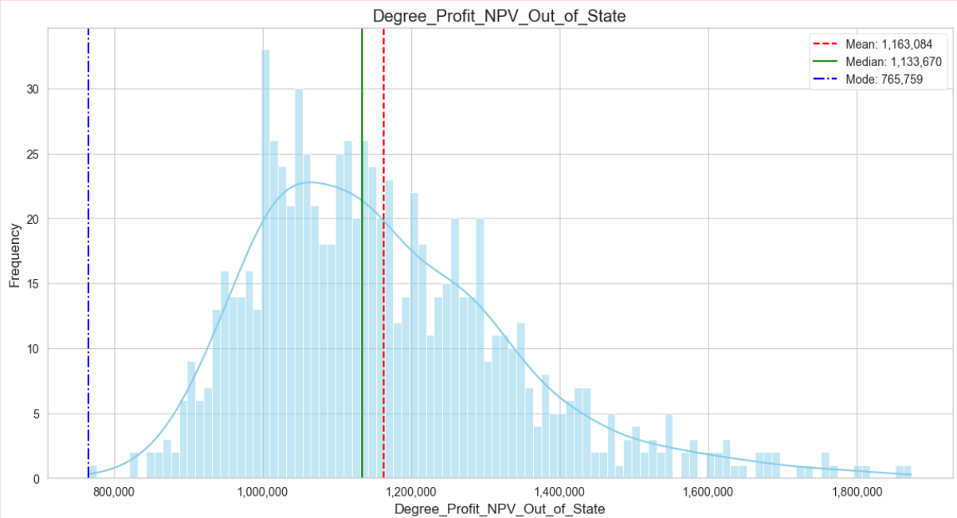
Analysis- By college

Slide 19
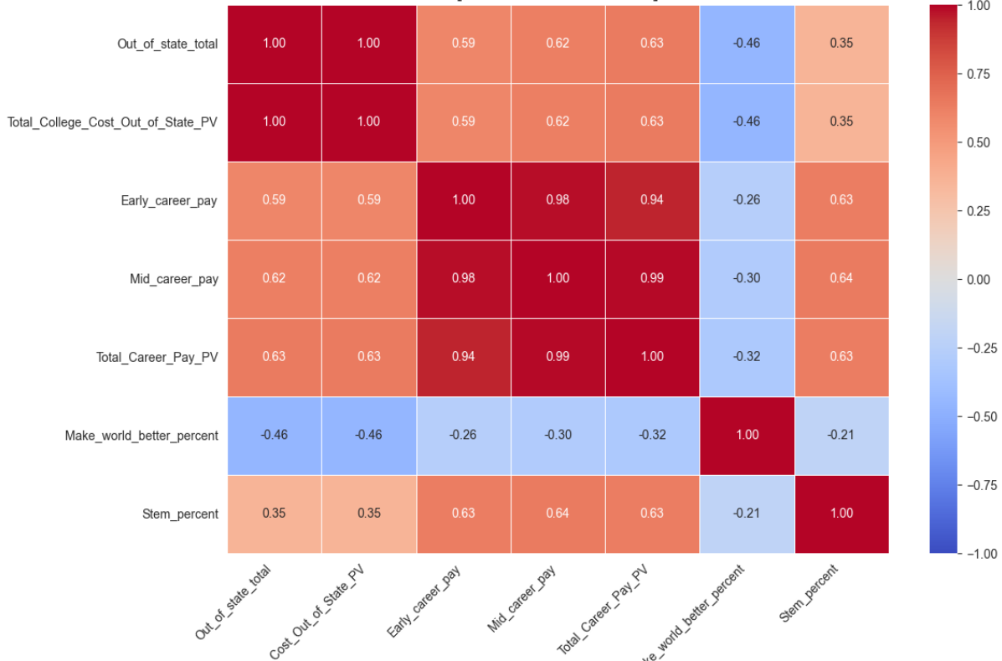
Analysis- Tuition Salary Correlations

Slide 20
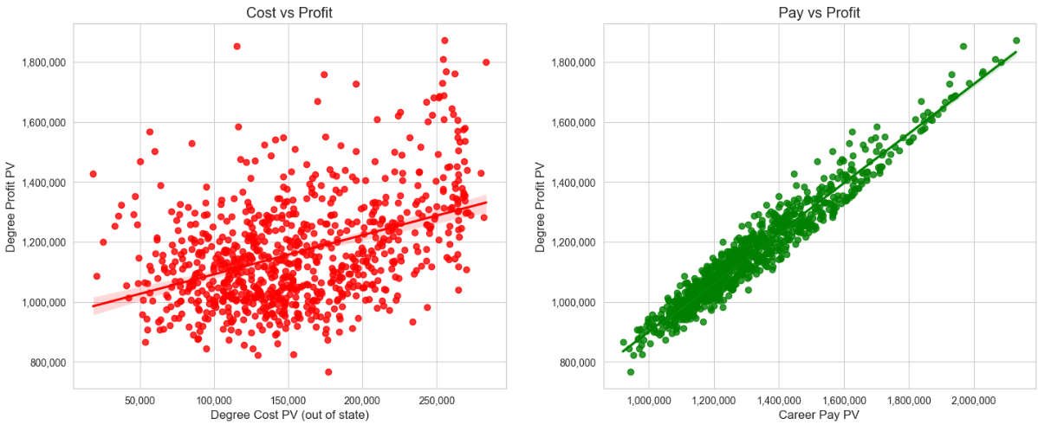
Analysis- Cost, Pay, Profit

Slide 21
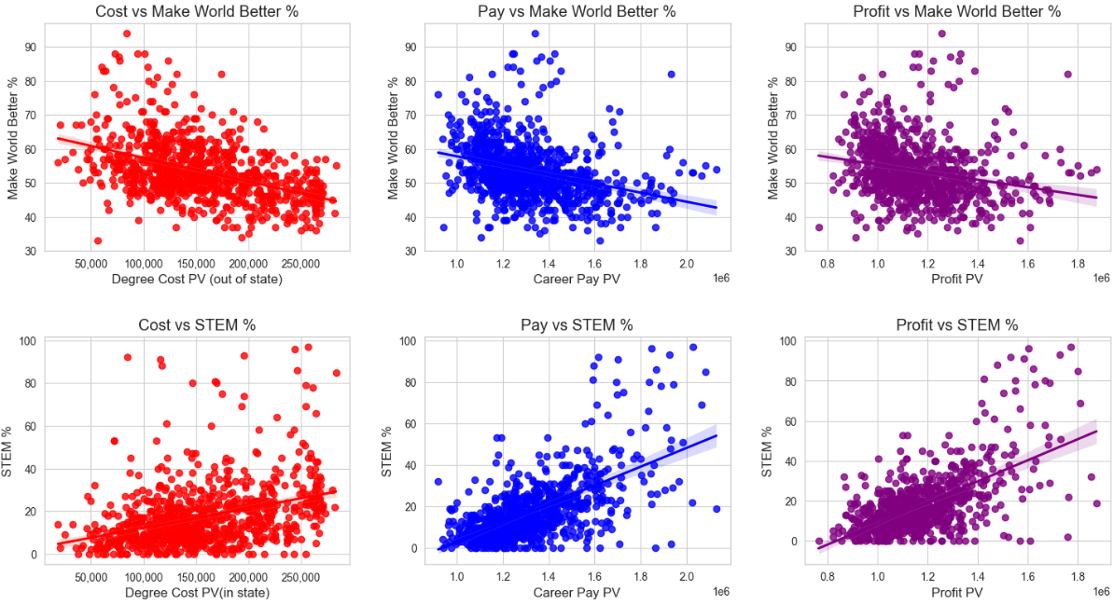
analysis- Cost, Pay, Profit

Slide 22
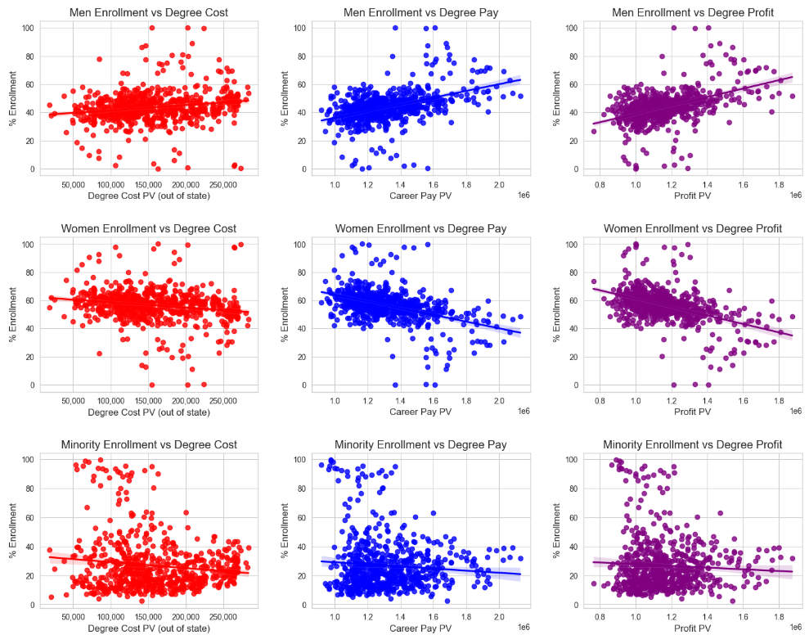
analysis- Cost, Pay, Profit

Slide 23
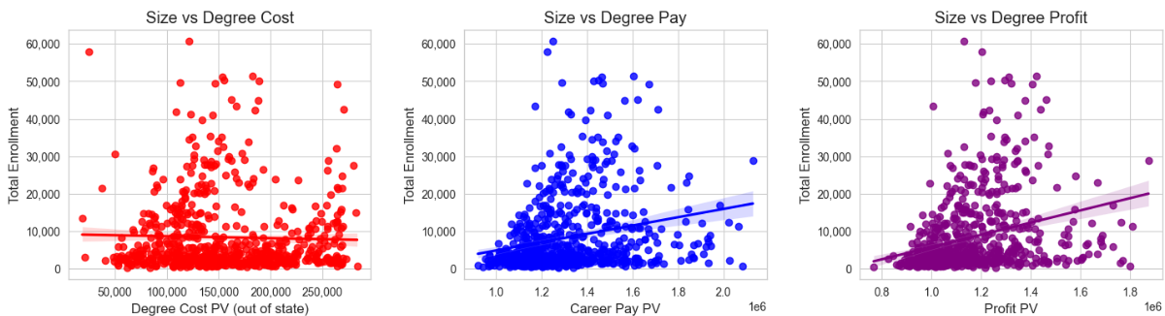
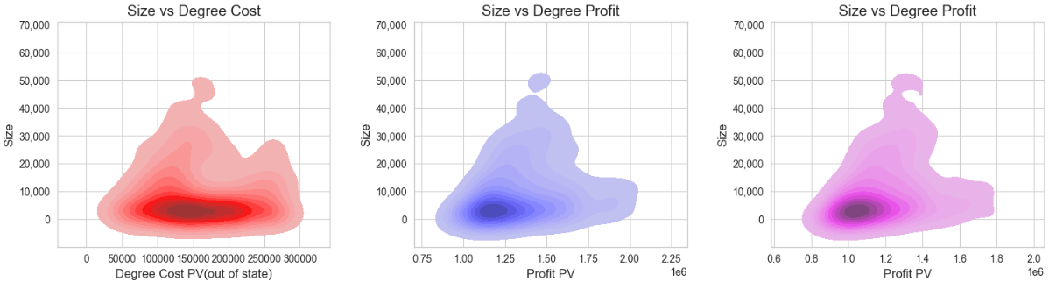
Analysis- Cost, Pay, Profit

Slide 24
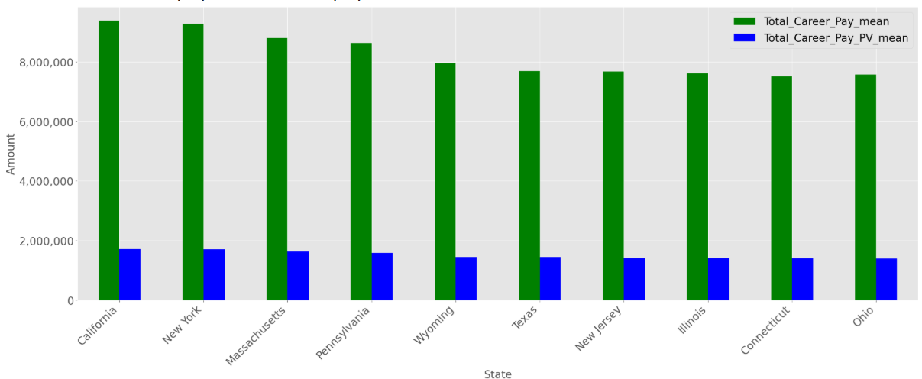
Analysis- By state
Top 10 Highest Paying- Total vs PV

Slide 25
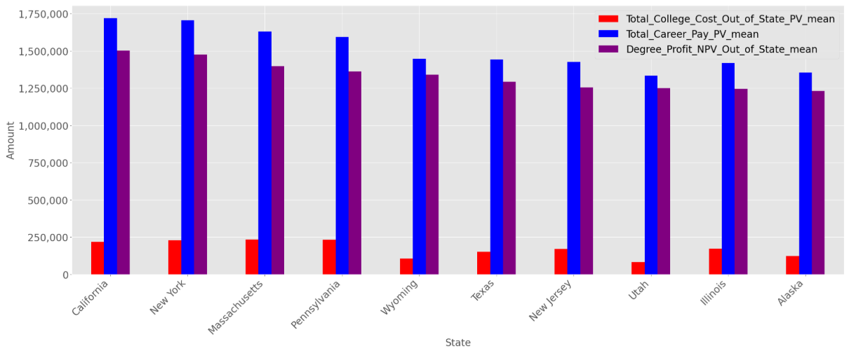
Analysis- By state
Most Profitable

Slide 26
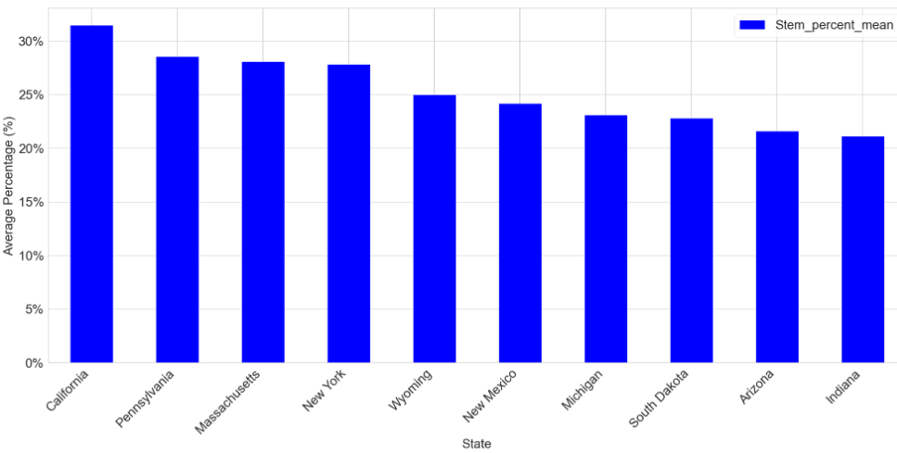
Analysis- By state
Highest STEM%

Slide 27
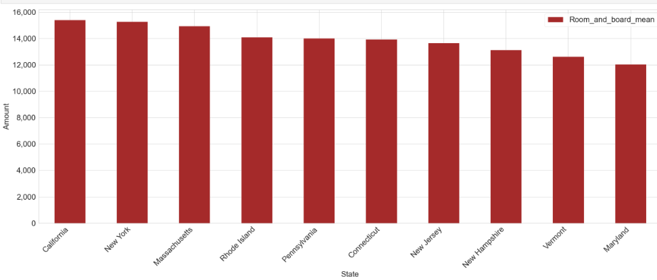
Analysis- By state
Room & Board

Slide 28
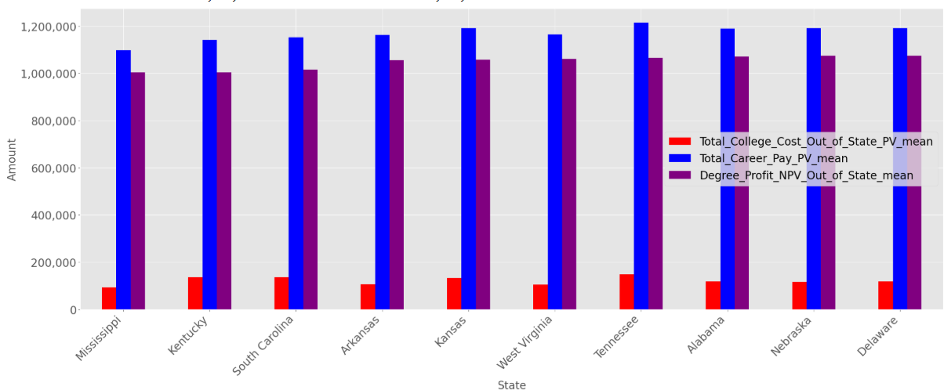
Analysis- By state
Least Profitable

Slide 29
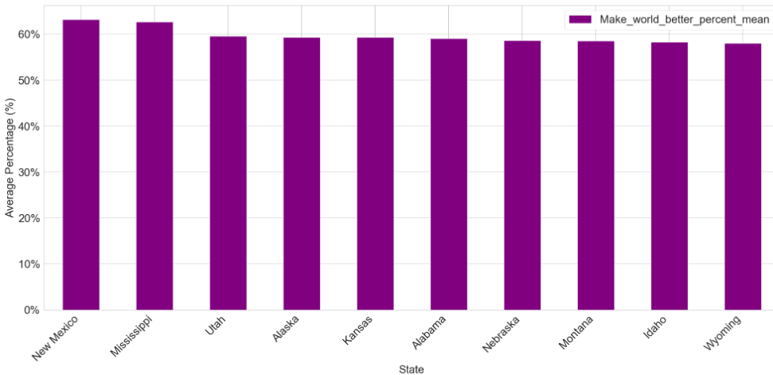
Analysis- By state
Highest Make World Better %

Slide 30
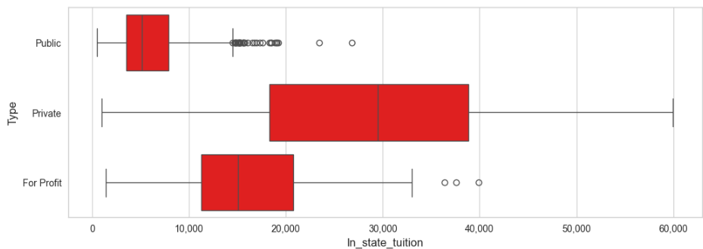
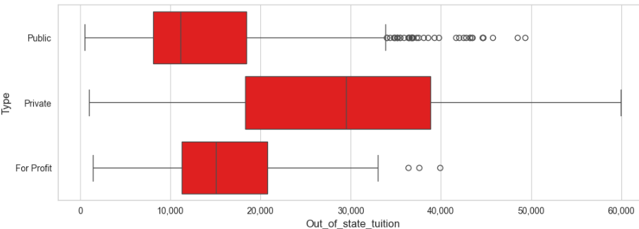
Analysis- By type
Tuition (In State)
Tuition (Out of State)

Slide 31
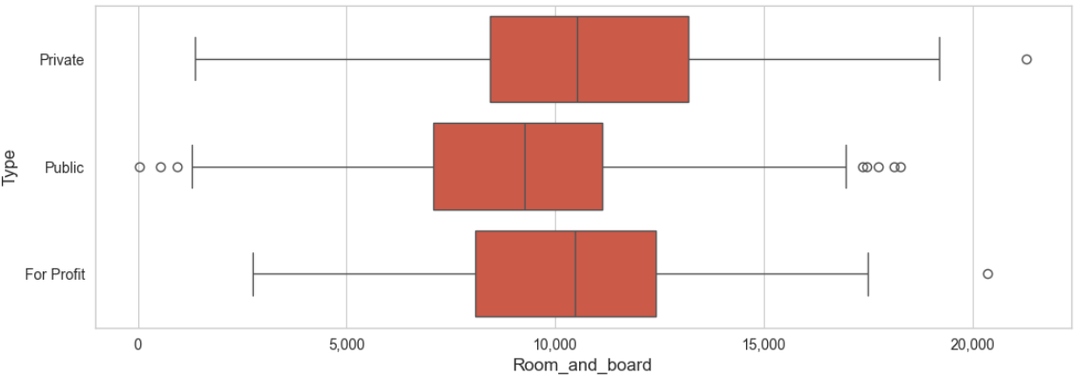
Analysis- By type
Room & Board

Slide 32
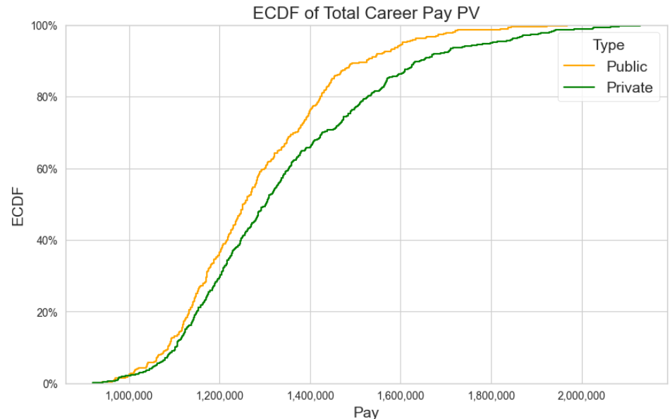
Analysis- By type

Slide 33
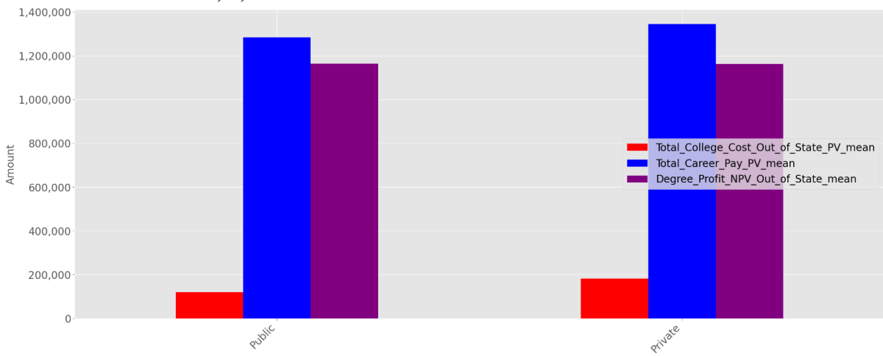
Analysis- By type
Profitability

Slide 34
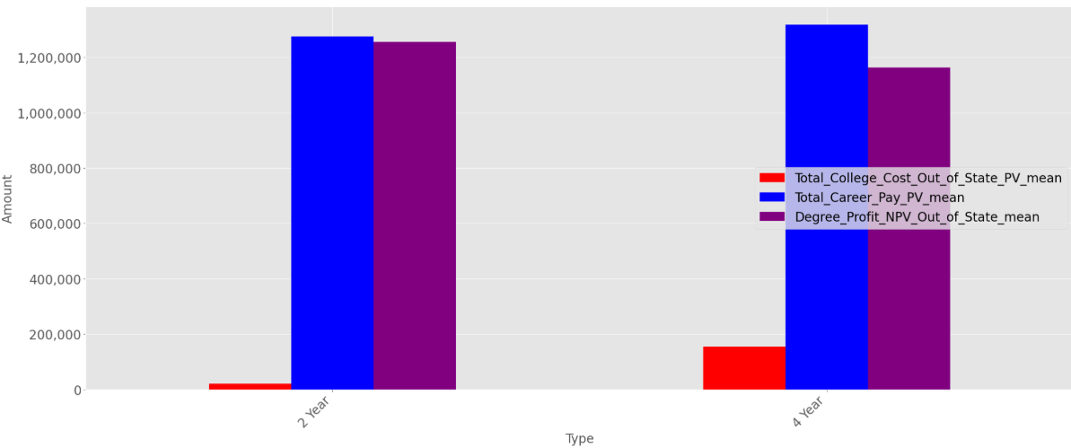
Analysis- By Degree Length
Profitability

Slide 35
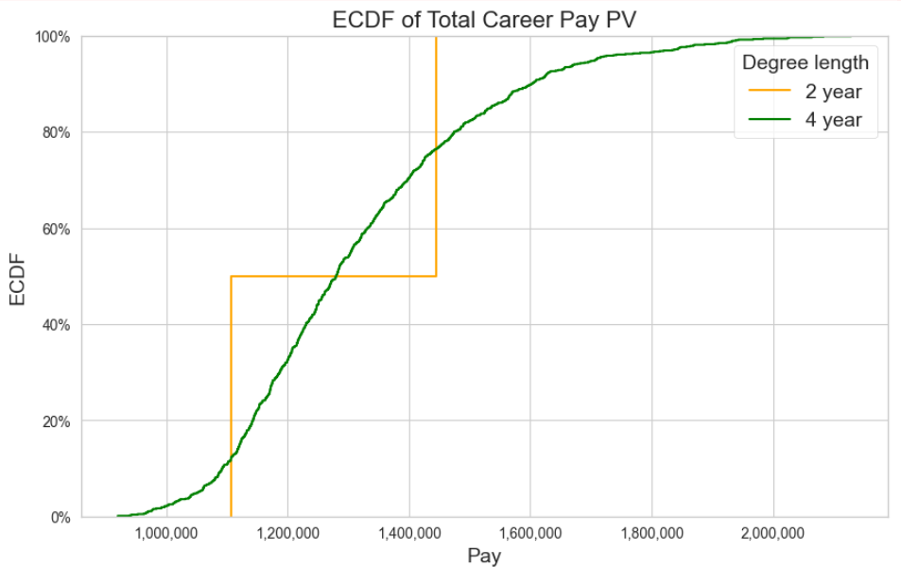
Analysis- By Degree Length

Slide 36

Conclusions- Most lucrative Schools
Concentrated in CA, NY, MA, PA
Highest Future Earnings, mostly regardless of cost
High Earnings to cost ratio put SUNY Maritime at the top
Also, Most Expensive
Higher Tuition, Room & Board
High Cost of Living States
High STEM %, Low Make World Better %
Large
NPV of Future Earnings & Costs significant factor

Slide 37


Conclusions- Most Expensive Schools
Public colleges cheaper than For Profit & Private
Even when out of state
Even have lowest room & board
High STEM % schools more expensive, High Make World Better % less expensive
No correlation with School Size

Slide 38

Future Work
Comparison to Career Paths without any College
By Degree, Career Path
By School Rank
Bootcamps
International
Income Tax in other States

Slide 39

Questions?

Slide 40
Image References
https://www.pexels.com/photo/people-sitting-inside-well-lit-room-159740/
https://www.pexels.com/photo/woman-holding-black-wallet-3768145/
https://www.pexels.com/photo/gray-and-black-laptop-computer-265087/
https://www.pexels.com/photo/stock-exchange-board-210607/
https://www.pexels.com/photo/woman-sitting-on-an-office-chair-with-money-flying-all-around-her-7654610/
https://www.pexels.com/photo/woman-and-receipts-on-desk-5900131/
https://www.pexels.com/photo/exhausted-woman-holding-her-head-6919710/
https://www.pexels.com/photo/man-standing-in-the-middle-of-road-1553783/
https://www.pexels.com/photo/person-holding-white-scroll-2292837/

